Slide 1
Lowest common multiple
Properties of number: factors, multiples, squares and cubes

Slide 2
how to use Oak lessons

Slide 3
I can use the prime factorisation of two or more positive integers to efficiently find their lowest common multiple.

Slide 4
The lowest common multiple is the lowest number that is a multiple of two or more numbers.
LCM is an abbreviation for lowest common multiple.

Slide 5

Lowest common multiple
Common multiples using prime factorisation
Lowest common multiple using prime factorisation
Lowest common multiple of more than two numbers

Slide 6
Common multiples using prime factorisation
How do we find the first five multiples of a number?
Multiples of 3
1st multiple = 1 × number
2nd multiple = 2 × number
3rd multiple = 3 × number
4th multiple = 4 × number
5th multiple = 5 × number
1 × 3 = 3
2 × 3 = 6
3 × 3 = 9
4 × 3 = 12
5 × 3 = 15

Slide 7
Common multiples using prime factorisation
Multiples of 2² × 3
1 × 2² × 3 =
2 × 2² × 3 =
3 × 2² × 3 =
4 × 2² × 3 =
5 × 2² × 3 =
2² × 3
2³ × 3
2² × 3²
2² × 2² × 3 =
2² × 3 × 5
2⁴ × 3
2⁴ × 3

Slide 8
Common multiples using prime factorisation
Multiples of 2 × 3 × 5
1 × 2 × 3 × 5 =
2 × 2 × 3 × 5 =
3 × 2 × 3 × 5 =
4 × 2 × 3 × 5 =
5 × 2 × 3 × 5 =
2 × 3 × 5
2² × 3 × 5
2 × 3² × 5
2² × 2 × 3 × 5 =
2 × 3 × 5²
2³ × 3 × 5
2³ × 3 × 5

Slide 9
Common multiples using prime factorisation
Multiples of 2² × 3
Multiples of 2 × 3 × 5
2² × 3
2³ × 3
2² × 3²
2⁴ × 3
2² × 3 × 5
2 × 3 × 5
2² × 3 × 5
2 × 3² × 5
2³ × 3 × 5
2 × 3 × 5²
2² × 3 × 5 is a common multiple of 2² × 3 and 2 × 3 × 5
The multiples of 2² × 3 × 5 will always be common multiples of
2² × 3 × 5 & 2 × 3 × 5
e.g. 2² × 3 × 5²

Slide 10
Common multiples using prime factorisation
Multiples of 2² × 3²
examples
non-examples
2² × 3² × 2
It’s the 2nd multiple
2 × 3², 2² × 3² is not a factor
2² × 3, 2² × 3² is not a factor
2² × 3² × 5
It’s the 5th multiple
2² × 3 × 5, 2² × 3² is not a factor
2² × 3³ × 5² = 2² × 3² × 3 × 5²
It’s the 75th multiple

Slide 11
Common multiples using prime factorisation
30 = 2 × 3 × 5
18 = 2 × 3 × 3
What is the same and what is different about these two products?
e.g. Both of them have factors of 2 and 3
Both of them are the product of 3 integers
The 3rd integer is different in each of them

Slide 12
Common multiples using prime factorisation
30 = 2 × 3 × 5
18 = 2 × 3 × 3
114 = 6 × 19
What is the same and what is different about these three products?
e.g.
They are all products.
The top two are products of three integers and the bottom one is a product of only two integers.
The top two only use prime numbers but the bottom one uses a composite number and a prime number.

Slide 13
Common multiples using prime factorisation
30 = 2 × 3 × 5
18 = 2 × 3 × 3
114 = 6 × 19
How can we rewrite the third product to be more similar to the original two?
114 = 6 × 19
114 = 2 × 3 × 19

Slide 14
Common multiples using prime factorisation
These are all multiples of 6
Write them as products of 2 × 3
12
78
102
12 = 6 × 2
12 = 2 × 3 × 2
12 = 2² × 3
78 = 6 × 13
78 = 2 × 3 × 13
102 = 6 × 17
102 = 2 × 3 × 17

Slide 15

Common multiples using prime factorisation
2³ × 3² is a multiple of 2² × 3²
2³ × 3² = 2² × 3² × 2, so it’s the second multiple of 2³ × 3²
The exponent of 2 is odd so it is not a multiple.

Slide 16
Common multiples using prime factorisation
1) Write the first eight multiples of the following as products:
3 × 5
2² × 3
2 × 3² × 5
What is the first common multiple of 15 and 12?

Slide 17
Common multiples using prime factorisation
1) Write the first eight multiples of the following as products:
3 × 5
2² × 3
2 × 3² × 5
What is the first common multiple of 15 and 12?
3 × 5, 2 × 3 × 5, 3² × 5, 2² × 3 × 5, 3 × 5², 2 × 3² × 5, 3 × 5 × 7, 2³ × 3 × 5
2² × 3, 2³ × 3, 2² × 3², 2⁴ × 3, 2² × 3 × 5, 2³ × 3², 2² × 3 × 7, 2⁵ × 3
2 × 3² × 5, 2² × 3² × 5, 2 × 3³ × 5, 2³ × 3² × 5, 2 × 3² × 5², 2² × 3³ × 5, 2 × 3² × 5 × 7, 2⁴ × 3² × 5
15
12
d) the common multiple is 2² × 3 × 5 = 60

Slide 18
Lowest common multiple
Common multiples using prime factorisation
Lowest common multiple using prime factorisation
Lowest common multiple of more than two numbers

Slide 19
Lowest common multiple using prime factorisation
What would the lowest common multiple of 24 and 40?
24 = 2³ × 3
40 = 2³ × 5
factor × factor = product
multiple
For an integer to be a common multiple of both numbers it must be a product of two common factors.
Prime factors of 24
Prime factors of 40
2³ × 3
× 5
× 3
3
2³
5
2³ × 5
So, the LCM of 24 and 40 is 2³ × 3 × 5
= 120
Hopefully you have noticed that the LCM is the product of all of the prime factors in the Venn diagram.

Slide 20
Lowest common multiple using prime factorisation
Find the lowest common multiple of 360 and 2100
360 = 2³ × 3² × 5
2100 = 2² × 3 × 5² × 7
2³ × 3² × 5
2² × 3 × 5² × 7
2²
× 3
× 5
× 2
× 3
× 5
× 7
2²
× 3
× 5
× 5
× 7
× 2
× 3
Prime factors of 360
Prime factors of 2100
2
2²
7
3
3
5
5
The LCM of 360 and 2100 is 2³ × 3² × 5² × 7 = 12 600

Slide 21
Lowest common multiple using prime factorisation
Find the LCM of 300 and 504
300 = 2² × 3 × 5²
504 = 2³ × 3² × 7
Find the LCM of 648 and 540
648 = 2³ × 3⁴
540 = 2² × 3³ × 5
Prime factors of 300
Prime factors of 504
Prime factors of 648
Prime factors of 540
2²
2
2²
5²
3
2
5
3
7
3
3³
The LCM of 300 and 504 is:
The LCM of 648 and 540 is :
2³ × 3² × 5² × 7
= 12 600
2³ × 3⁴ × 5
= 3240

Slide 22
Lowest common multiple using prime factorisation
Find the LCM of the following pairs of numbers:
a)
56 = 2 × 2 × 2 × 7
140 = 2 × 2 × 5 × 7
b)
84 = 2 × 2 × 3 × 7
70 = 2 × 5 × 7
The LCM of 56 and 140 is .
The LCM of 84 and 70 is .
c)
2016 = 2⁵ × 3² × 7
1512 = 2³ × 3³ × 7
The LCM of 2016 and 1512 is .

Slide 23
Lowest common multiple using prime factorisation
2) The LCM of the 420 and another number is represented in the Venn diagram is 1260.
What is the missing prime factor?
What was the other number?
3
2²
5
7

Slide 24
Lowest common multiple using prime factorisation
Find the LCM of the following pairs of numbers:
a)
56 = 2 × 2 × 2 × 7
140 = 2 × 2 × 5 × 7
b)
84 = 2 × 2 × 3 × 7
70 = 2 × 5 × 7
2
2
2
2
5
2
5
7
7
3
The LCM of 56 and 140 is 280
The LCM of 84 and 70 is 420
c)
2016 = 2⁵ × 3² × 7
1512 = 2³ × 3³ × 7
2³
2²
3²
3
The LCM of 2016 and 1512 is 6048
7

Slide 25
Lowest common multiple using prime factorisation
2) The LCM of the 420 and another number is represented in the Venn diagram is 1260.
What is the missing prime factor?
What was the other number?
Prime factors of 420
3
3
2²
5
7
2² × 3 × 5 × 7 × 3 = 1260
The other number is 2² × 3² × 7 = 252

Slide 26
Lowest common multiple
Common multiples using prime factorisation
Lowest common multiple using prime factorisation
Lowest common multiple of more than two numbers

Slide 27
Lowest common multiple of more than two numbers
Find the LCM of 84, 900 and 225
84 = 2² × 3 × 7
900 = 2² × 3² × 5²
225 = 3² × 5²
Prime factors of 84
Prime factors of 900
2²
7
3
3
5²
Prime factors of 225
The LCM of 84, 900 and 225 is 2² × 3² × 5² × 7
= 6300

Slide 28
Lowest common multiple of more than two numbers
Find the LCM of 198, 270 and 1350
Prime factors of 198
Prime factors of 270
198 = 2 × 3² × 11
270 = 2 × 3³ × 5
1350 = 2 × 3³ × 5²
11
2
3²
3
5
5
Prime factors of 1350
The LCM of 198, 270 and 1350 is 2 × 3³ × 5² × 11
= 14 850

Slide 29
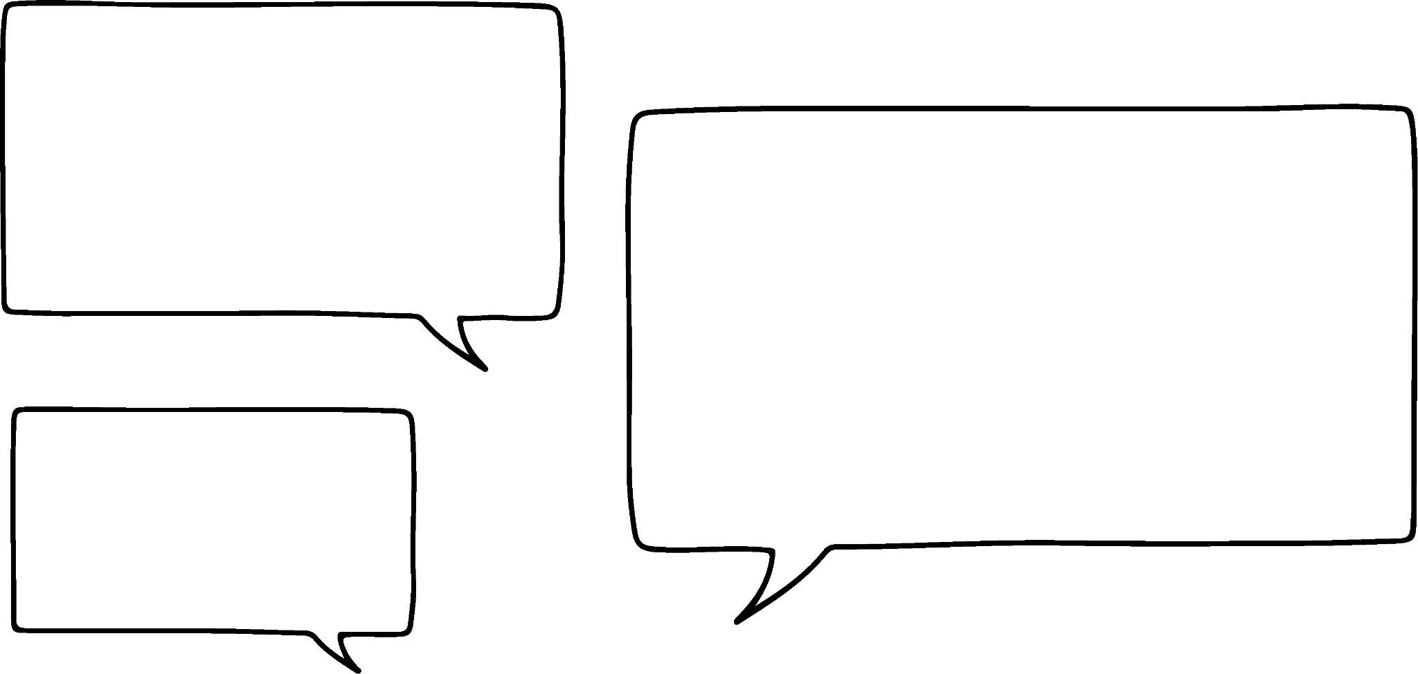

Lowest common multiple of more than two numbers
Prime factors of 60
Prime factors of 50
2
5
2
5
3
Prime factors of 210
7
The LCM of 60, 50 and 210 is 10
Do you agree with Alex?
Alex has found the HCF not the LCM.
This is a common mistake.
He should have found the product of all the factors.
Alex

Slide 30
Lowest common multiple of more than two numbers
Fill in the blanks.
180 = 2² × × 5
= 2² × 5 × 7
= 2² × 3 × 5 × 11
.
7
.
3
5
.
The LCM of 180, and is .

Slide 31
Lowest common multiple of more than two numbers
Fill in the blanks.
180 = 2² × 3² × 5
140 = 2² × 5 × 7
660 = 2² × 3 × 5 × 11
3
7
2²
3
5
11
The LCM of 180, 140 and 660 is 13 860

Slide 32
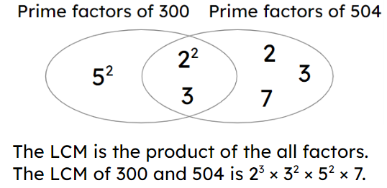
Lowest common multiple
Common multiples can be found using prime factorisation. The lowest common multiple of numbers can be found using prime factorisation and maybe a Venn diagram. E.g.

Slide 33

© Oak National Academy 2023.
Produced in partnership with Mathematics in Education and Industry.
Licensed on the Open Government Licence v3.0, except where otherwise stated. See Oak terms and conditions.

